Slide 1

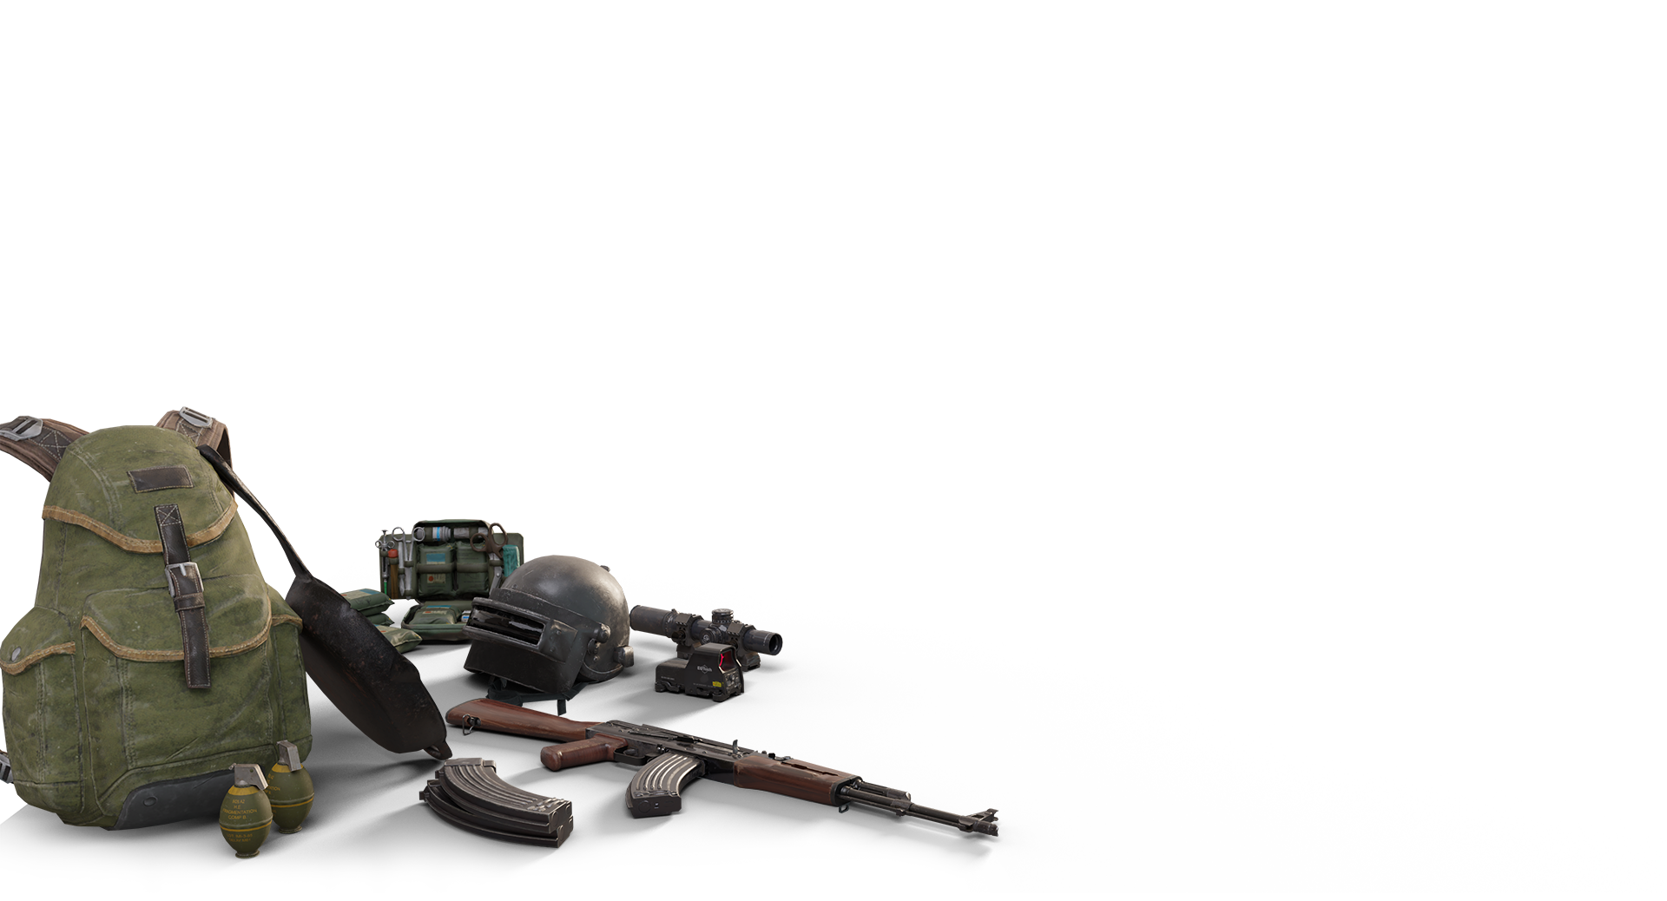
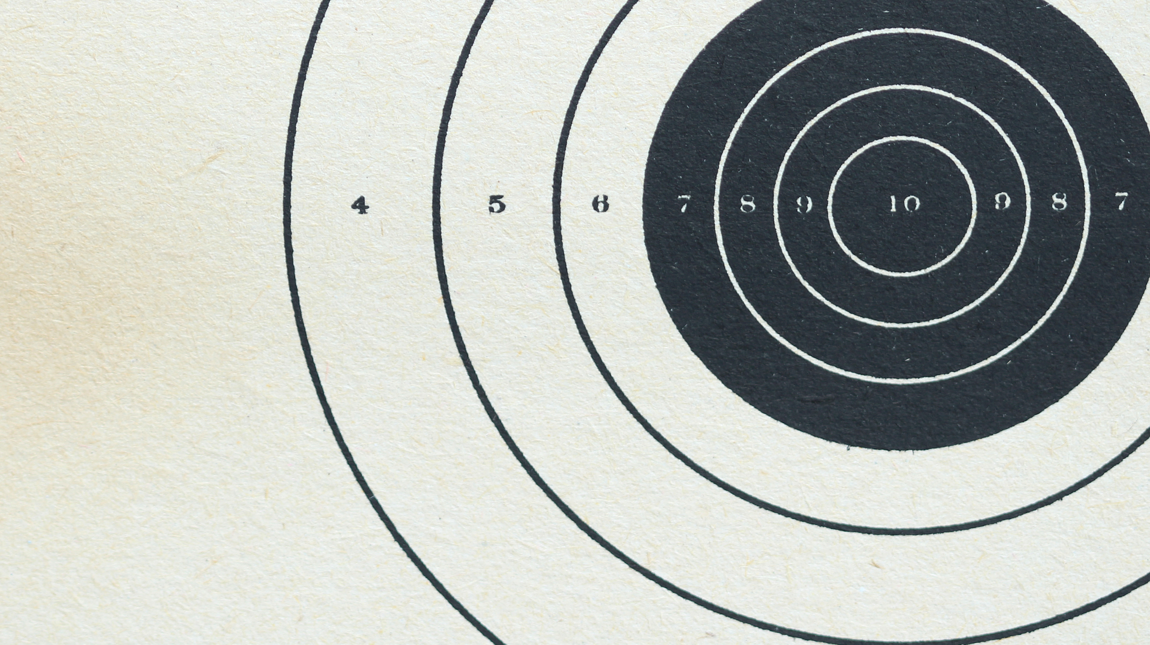

Balance in Everything
Jarvin Bayona
Notes:
Hello everybody, and today I’ll talk about game balance through the lens of a game commonly referred to as PUBG, or Player Unknown’s Battlegrounds. This game is what popularized what is known now as the battle royale genre.

Slide 2

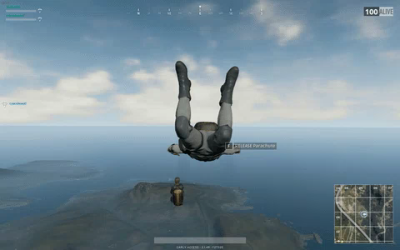
Notes:
In this game, players are dropped into a match either solo or with a squad, onto a large map. The goal of the game is to be the last person or squad standing. Around the map, players can find various tools and weapons to help them whittle down the competition. There are even vehicles to help with the map traversal.

Slide 3
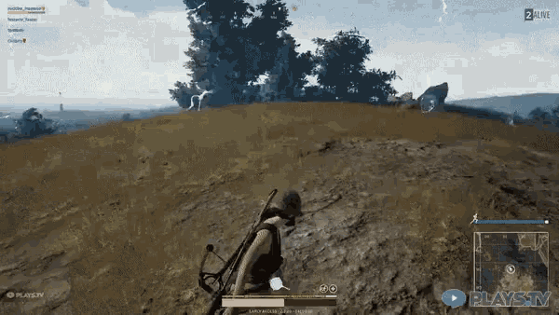


Notes:
Another component of the game is constantly dwindling player space, known as the blue circle of death. If a player is caught outside of this circle for too long, they will perish. Here, we see the final combatants of a match killing each other with the limited tools given in the game. You can see in the background the blue static circle that is encroaching on the players. If you still don’t get it, just think Hunger Games… or Battle Royale, the Japanese movie.

Slide 4
The Problem
We want our game to be fun
But how do we make it fun for everyone?
How do we ensure the game is fair?
Notes:
Here are some common problems that game developers have to tackle in order for their games to be successful and sell. This is especially true of video games that offer what is now called a ‘live service.’ This is just fancy jargon that means “we’ll keep updating the game in hopes that you buy other things in the game so we don’t have to come up with a whole ‘nother game.”
Game developers often know that their game needs to be fun, engaging, and fair for all to enjoy.

Slide 5
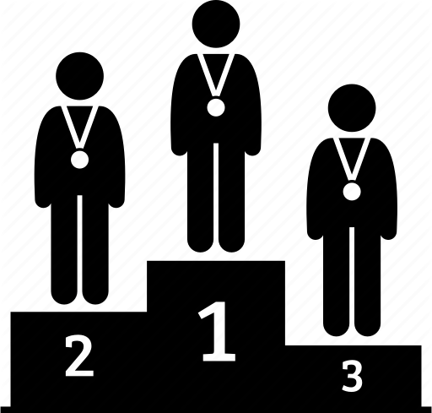
GOAL: BALANCE THE wins
Look at recall
Notes:
Game balance is a feature that game developers constantly wrangle with in order to maintain their player base. For many games, balance or lack of breaks popularity/playability. So what we’ll look at is how to balance PUBG in regards to its winners, specifically if they’re a top 3 finisher. If we see a specific feature of the game leading to more wins, say a gun, weapon, or position on the map, then maybe those things need balance. We look for recall as our metric to ensure that we capture every possible top finisher.

Slide 6



Tools used
Data pulled from a Kaggle competition
Originally had over 20GB of data, whittled down to 2gb
This Photo by Unknown Author is licensed under CC BY-SA
Notes:
Data was gathered from Kaggle, and I used these packages. I had to whittle down my data set because I was unable to set up AWS correctly. The data is 2 years old.

Slide 7
Some features offered
Player kill
Match data
Player Coordinates
Victim Coordinates
Weapon used to kill with
Player placement
Victim placement
Player damage
How many players
Which map is being played on
Time played in current match
Notes:
Here are most of the features this dataset offered me. I had an ample amount to deal with. All in all, over 12 million observations before dropping around 20 thousand of them.

Slide 8
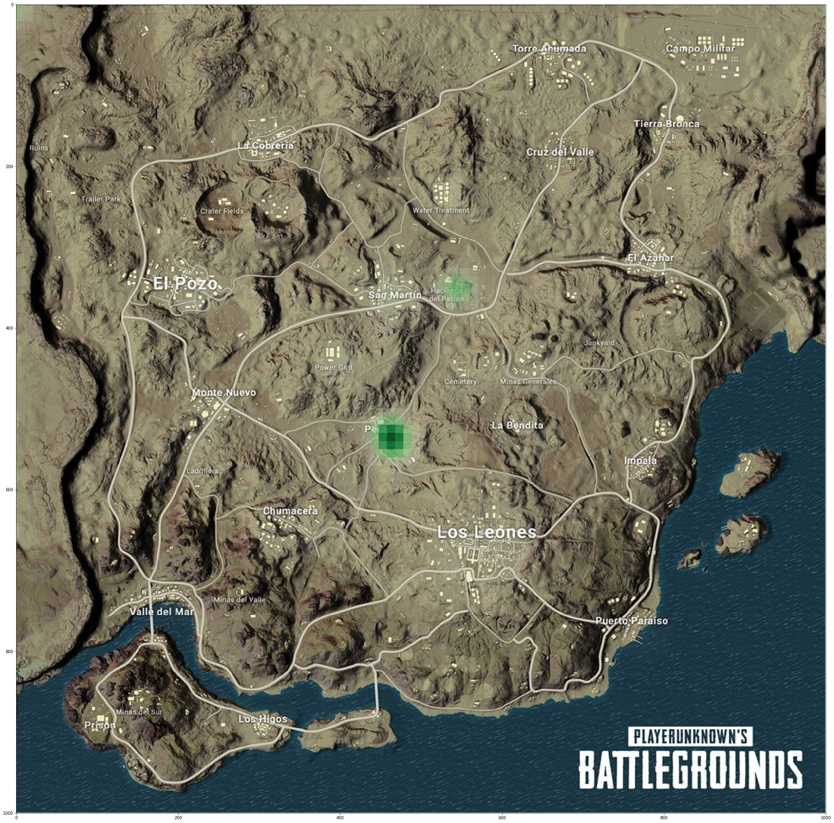
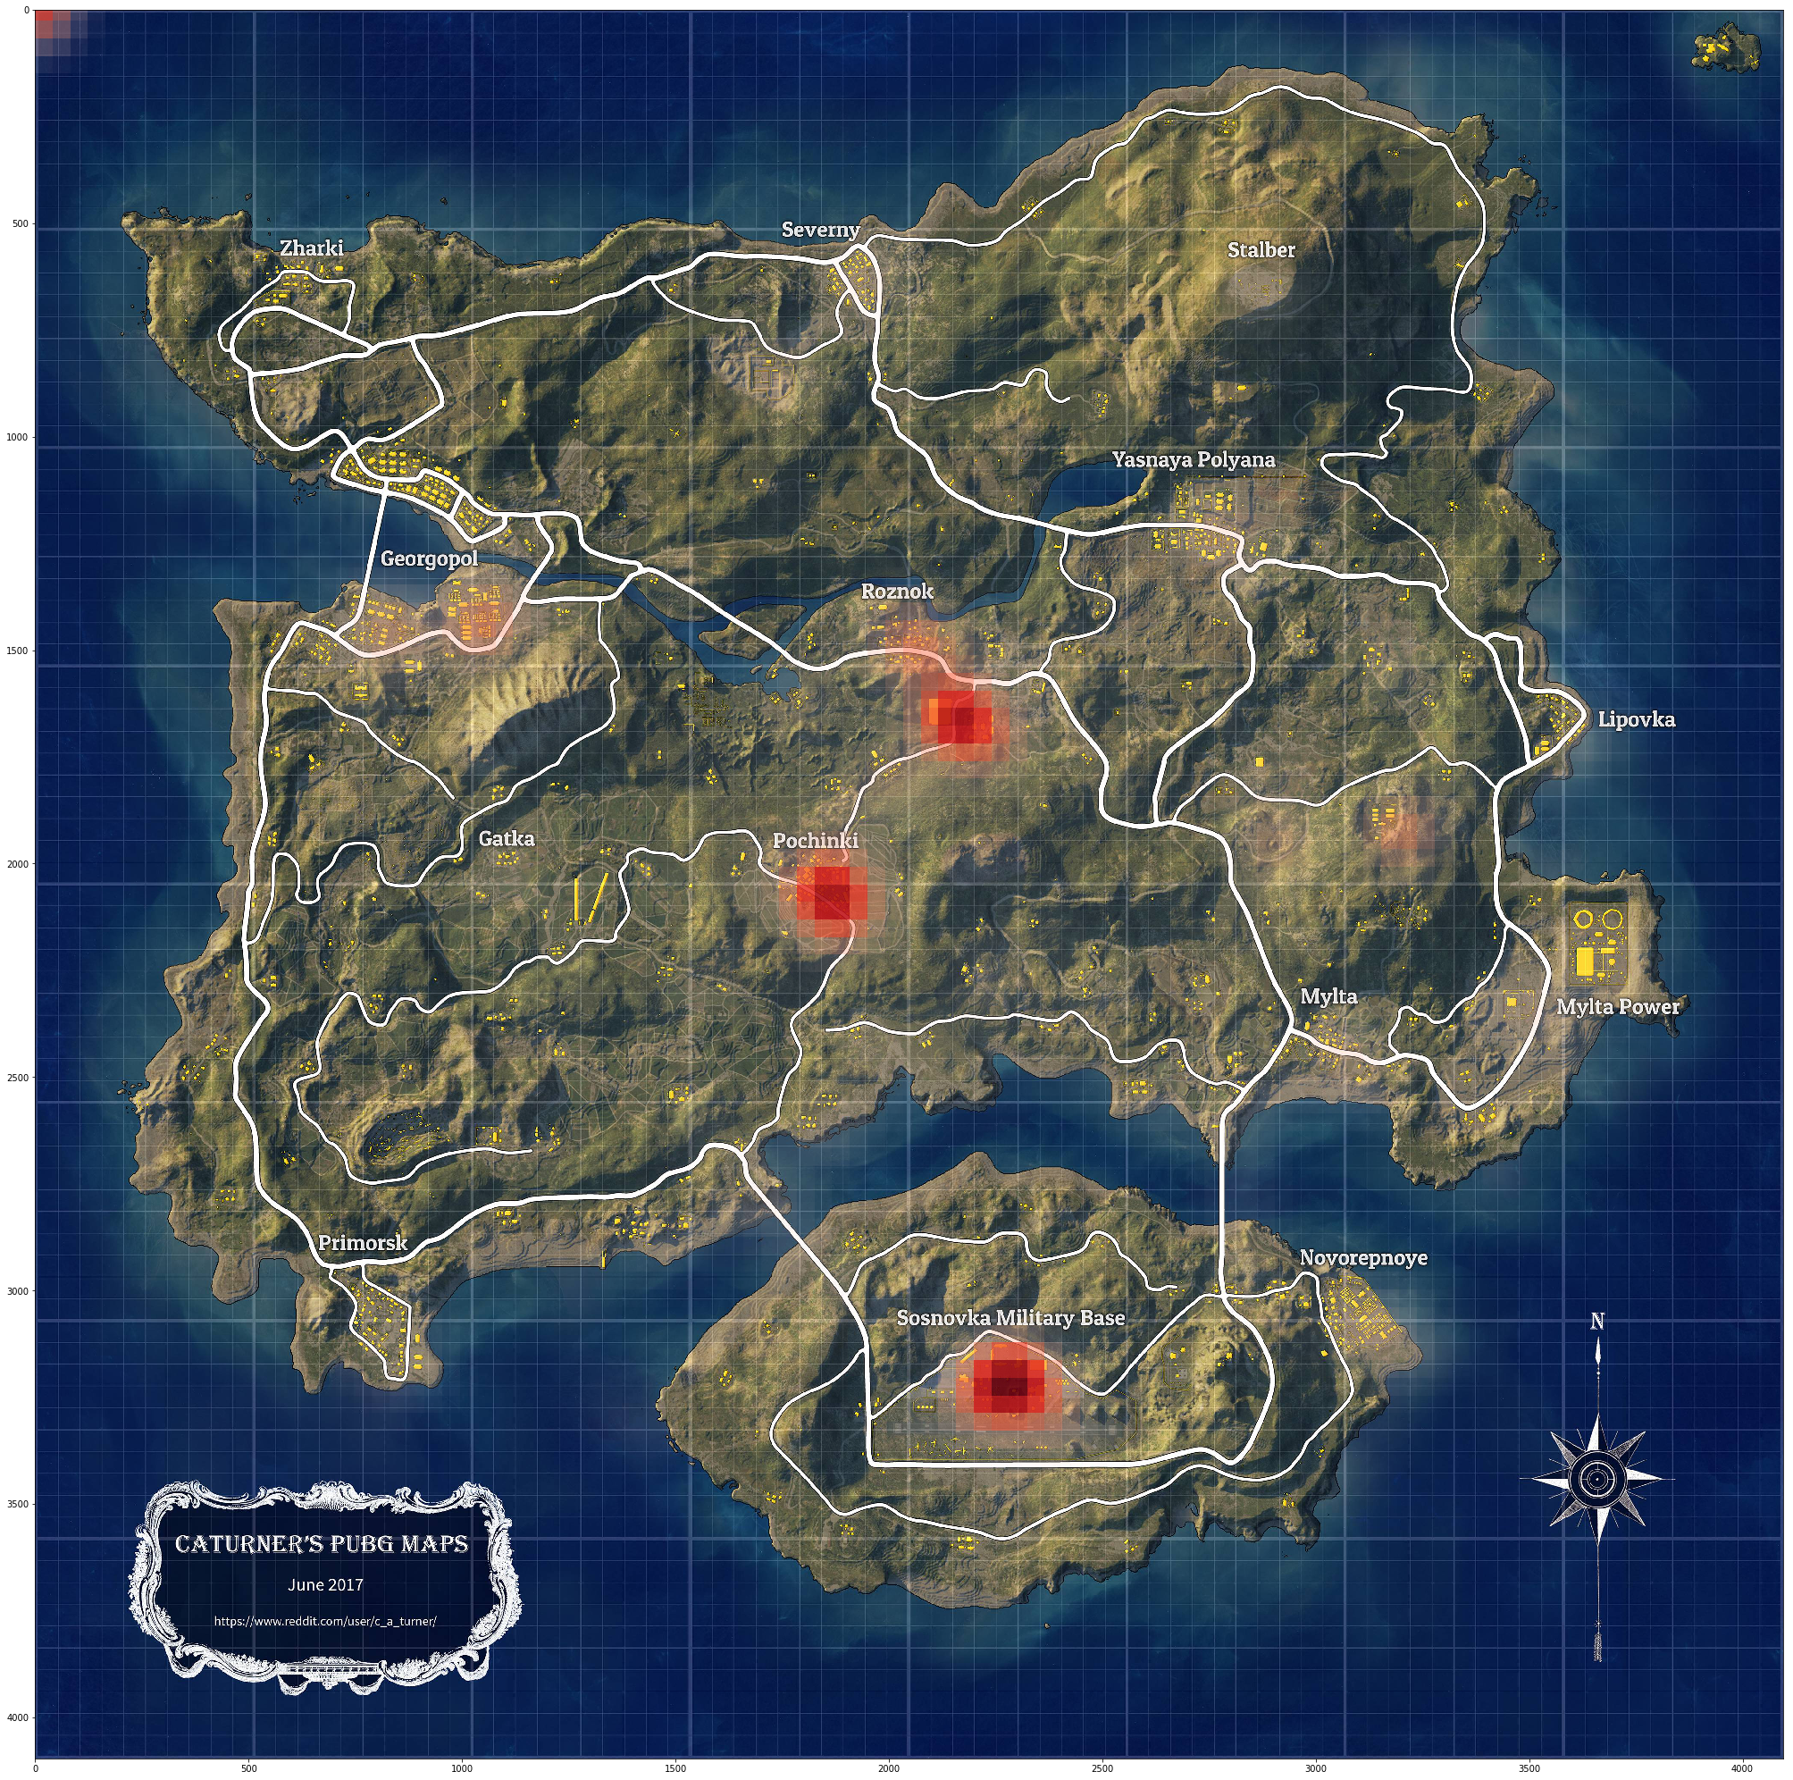
EDA First Findings:
Notes:
Some shnazzy plotting helped me find heatmaps of both the available maps at the time. In the first map, Erangel, the most concentration for deaths is at the Military Base, Pochinki, and this seemingly rural area outside of Roznok. I figured Pochinki was popular because of its central location, while the military base had high quality weapons for players to loot. I also learned that the rural region outside of Roznok is actually a school, and people just like to go on shooting sprees there, must be Americans. In the second map, Miramar, another central location that was picked as a high heat zone, as well as a location called Hacienda de Patron.

Slide 9
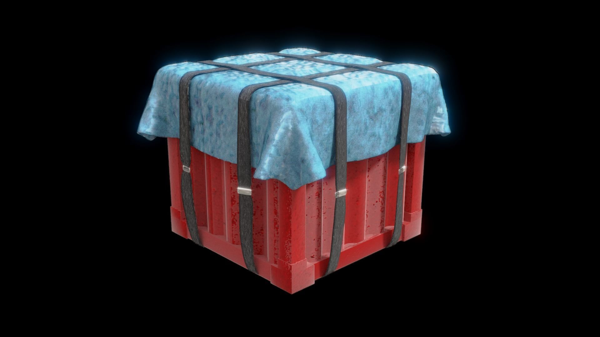
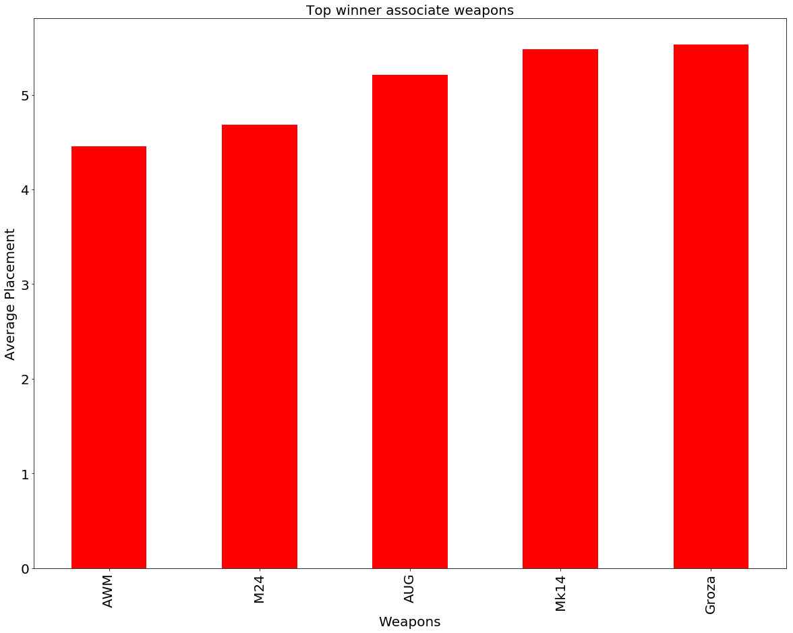
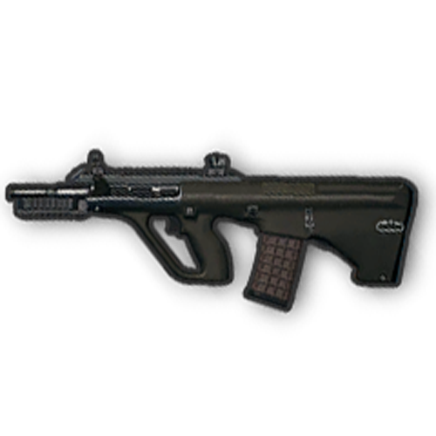
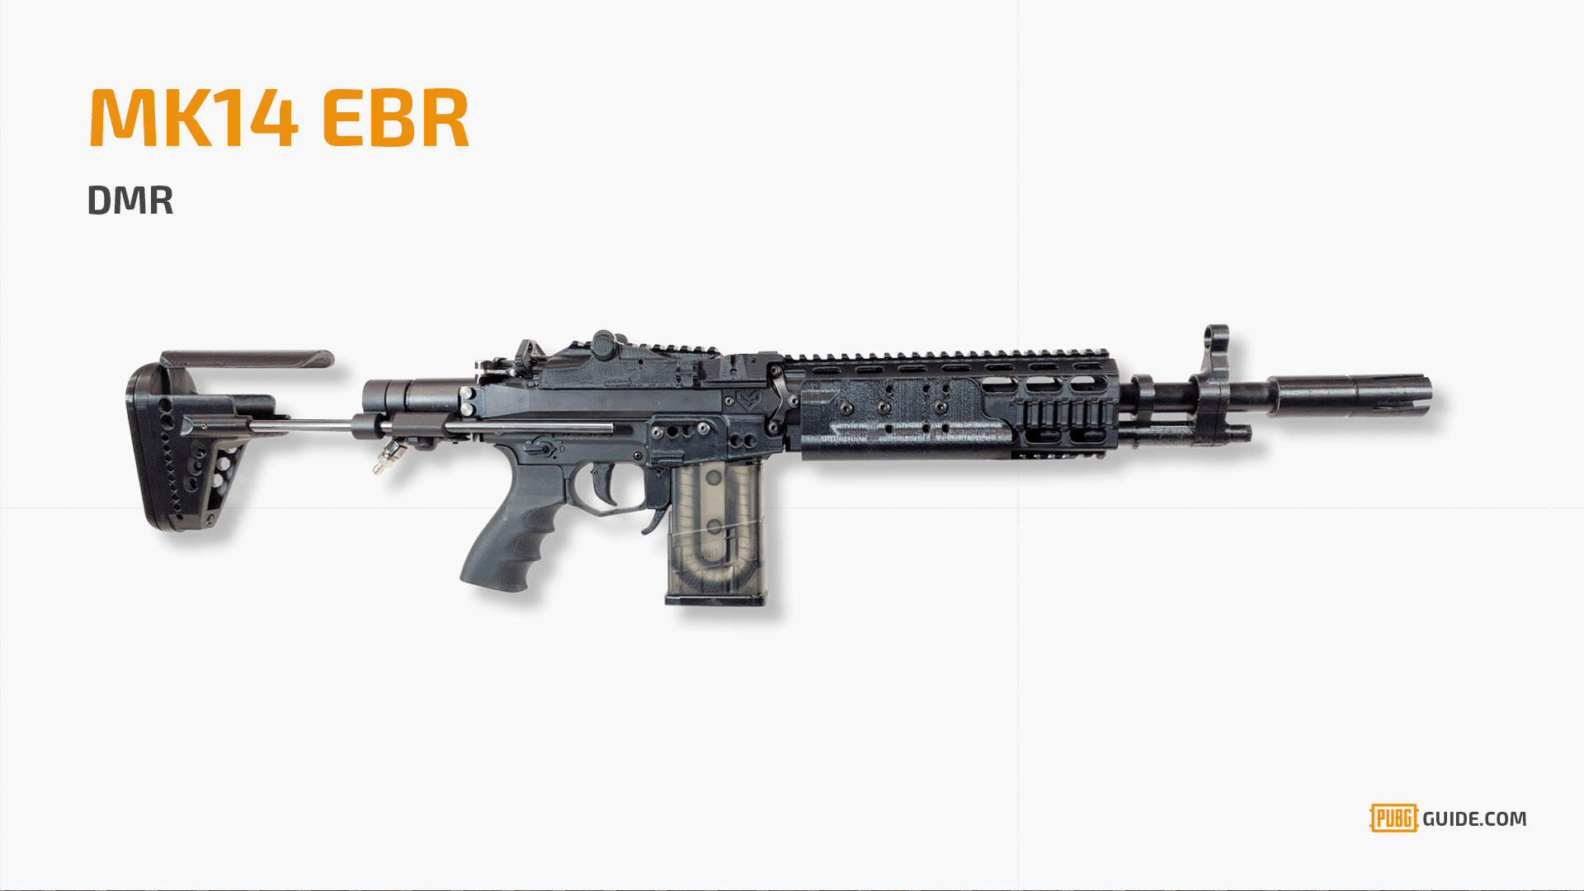
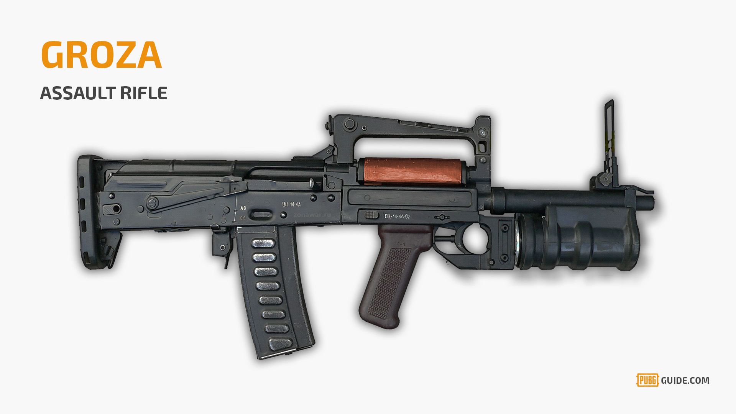
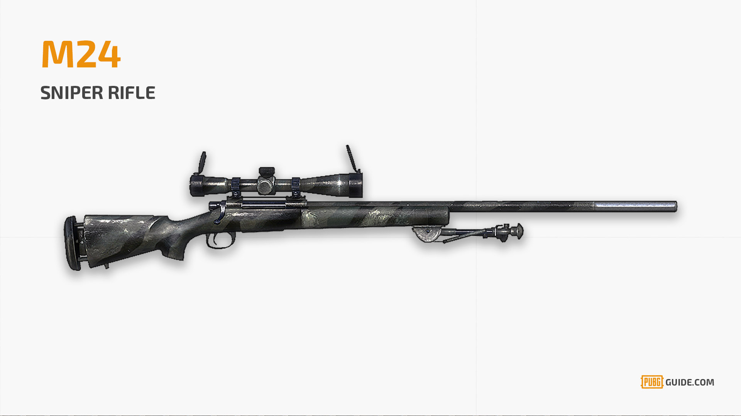
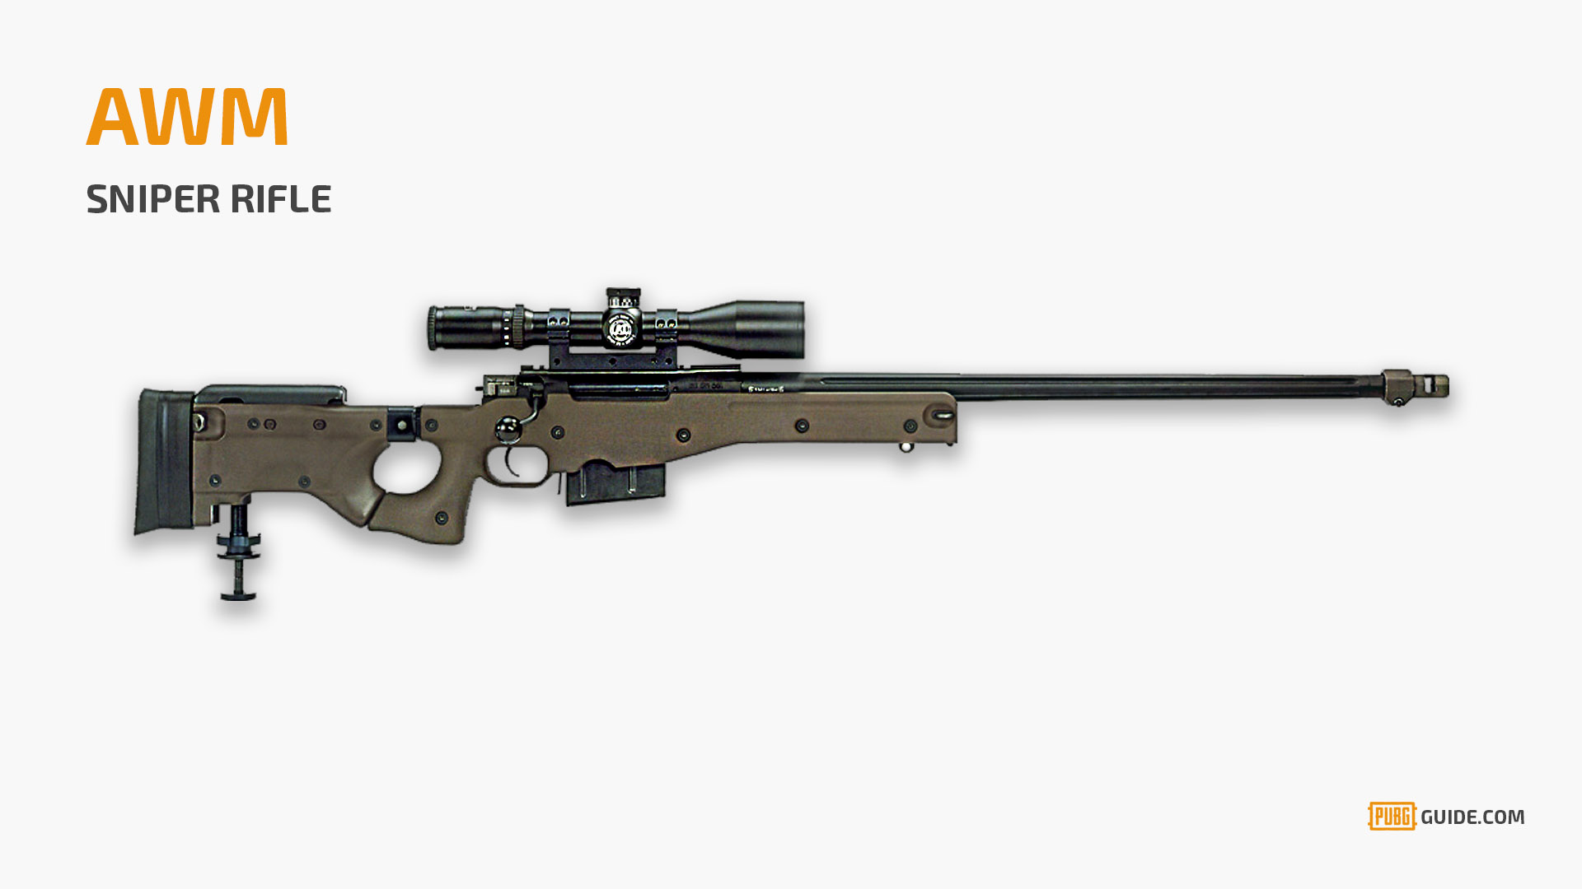
Notes:
Here comes a drop box. This shows us a graph of the most used weapon by top winners. It should actually be noted that almost all of these weapons can only be obtained from these drop boxes. These are high risk high reward weapons, and it seems as if they often pay off. This was pulled from seeing the average placement of people holding this weapons. Maybe we’ll see this reflected in the end coefficients.

Slide 10

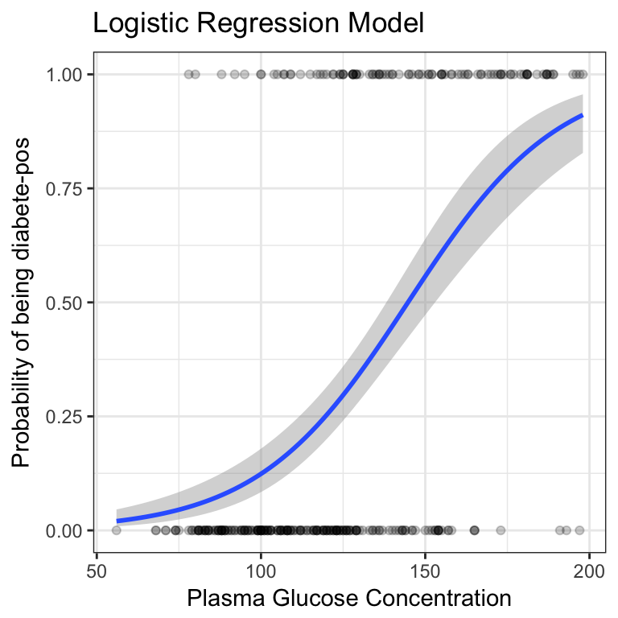
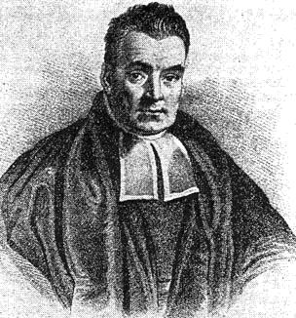

Throw a model at it:
?
Notes:
After EDA, it was time to model. I threw three different models at this data set, Naïve Bayes, Logistic Regression, and random forests. Naïve Bayes was good because the target is binomial, and there are more classical features than numeric ones. I thought Logistic regression might be a good idea because of the binomial target too. The problem is that both of these models suffer under heavy work load, and having 12 million observations was too taxing. This isn’t actually a random forest. It’s a forest in Russia, which is what that Erangel is based off of. I’m going into detail about the random forests because this is the model I ended up going with after validating the other two.

Slide 11
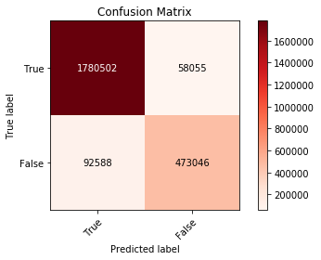
CONCLUSIONS:
Precision | Recall | F1
.80 | .82 | .80
Notes:
Random forests actually did a fairly good job at predicting. The metric I was looking for also was fairly high. A modest amount cross validation also ensured that I wasn’t overfitting. The true label means that the player or squad was able to get a top 3 finish.

Slide 12
Conclusions:
 | Feature | Coefficient
1 | Player Ride Distance | .184
2 | Player Coordinates | .146
3 | Victim Coordinates | .144
4 | Player Down But not Out | .083
5 | Player Assists | .078
6 | M416 | .004
Notes:
Now, getting a fancy model isn’t going to help us out too much in terms of just balancing the game. We need to look at what features are important and then possibly nerf or buff from there. The most important features according to the model seem to not be inherently showing imbalance on the weapons. Position seems to be a big feature though. So what we can determine from here is that map features will give players a bigger edge in terms of placing higher.

Slide 13
Website I definitely didn’t create
Please notice the didn’t.
Notes:
And here we have a webpage.

Slide 14


Slide 15


Future work
Utilize AWS
Utilize better libraries
Notes:
In the future, maybe I could try these things out.

Slide 16

PRESENTATION OVER

Slide 17
APpendix

Slide 18
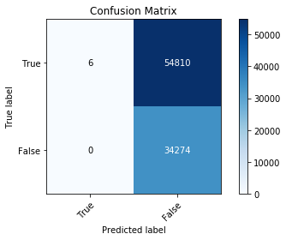
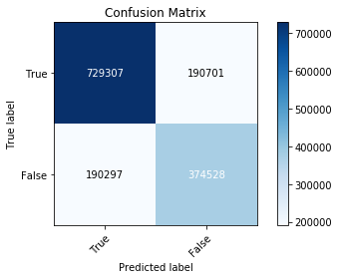
Stacked naïve bayes
Logistic regression

Slide 19
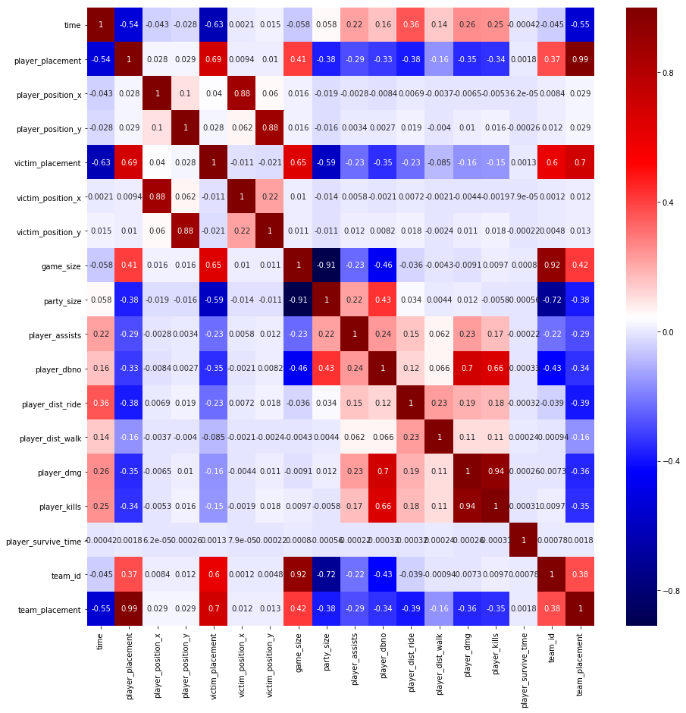

Slide 21
